Slide 1
Data Mining:CLUSTERING
By
Ginalford Marwein
Roll No-06
MCA 4th Semester

Slide 2
CONTENTS
Introduction
General Applications of Clustering
Desirable Properties of a Clustering
Overview of Clustering
Similarity Measures
Major Clustering Approaches
Partitioning Methods
Hierarchical Methods
Comparisons
Bibliography

Slide 3
Introduction
Cluster: a collection of data objects
Similar to one another within the same cluster
Dissimilar to the objects in other clusters
Cluster analysis
Grouping a set of data objects into clusters
Clustering is unsupervised classification: no predefined classes
Typical applications
As a stand-alone tool to get insight into data distribution
As a preprocessing step for other algorithms
Goal
is to place records into groups such that records in a group are similar to each other and dissimilar to records in other groups
The groups are usually disjoint
Identify such groupings (or clusters) in an unsupervised manner

Slide 4
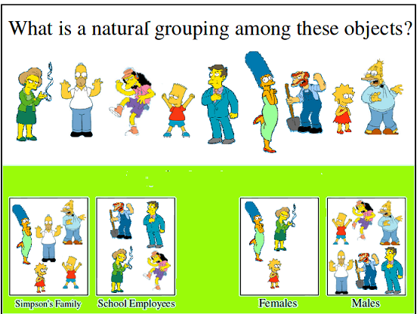
Examples

Slide 5
Why clustering?
• Organizing data into clusters shows internal structure of the data
– Ex. Clusty and clustering genes
• Sometimes the partitioning is the goal
– Ex. Market segmentation
• Prepare for other AI techniques
– Ex. Summarize news (cluster and then find centroid)
• Techniques for clustering is useful in knowledge discovery in data
– Ex. Underlying rules, reoccurring patterns, topics, etc.

Slide 6
General Applications of Clustering
Pattern Recognition
Spatial Data Analysis
create thematic maps in GIS by clustering feature spaces
detect spatial clusters and explain them in spatial data mining
Image Processing
Economic Science (especially market research)
WWW
Document classification
Cluster Weblog data to discover groups of similar access patterns

Slide 7
Clustering Applications
Marketing: Help marketers discover distinct groups in their customer bases, and then use this knowledge to develop targeted marketing programs
Land use: Identification of areas of similar land use in an earth observation database
Insurance: Identifying groups of motor insurance policy holders with a high average claim cost
City-planning: Identifying groups of houses according to their house type, value, and geographical location
Earth-quake studies: Observed earth quake epicenters should be clustered along continent faults

Slide 8
Desirable Properties of a Clustering
Scalability
Ability to deal with different types of attributes
Discovery of clusters with arbitrary shape
Minimal requirements for domain knowledge to determine input parameters
Able to deal with noise and outliers
Insensitive to order of input records
High dimensionality
Incorporation of user-specified constraints
Interpretability and usability

Slide 9
Overview
Feature Selection
identifying the most effective subset of the original features to use in clustering
Feature Extraction
transformations of the input features to produce new salient features.
Interpattern Similarity
measured by a distance function defined on pairs of patterns.
Grouping
methods to group similar patterns in the same cluster

Slide 10
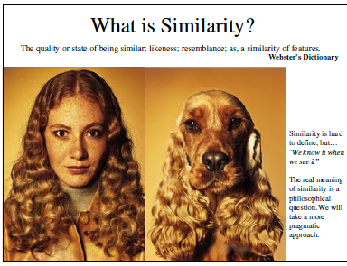
Similarity Measure

Slide 11

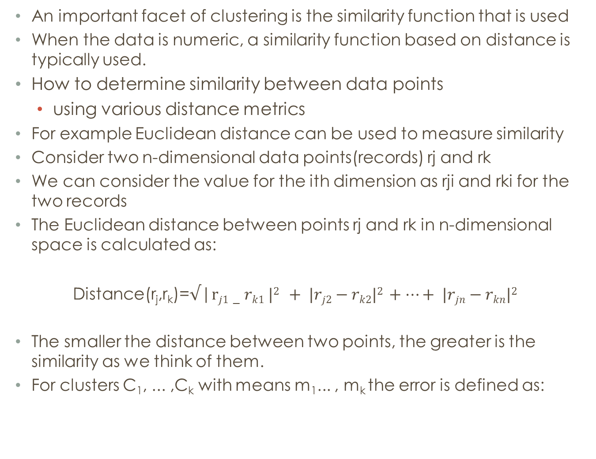
An important facet of clustering is the similarity function that is used
When the data is numeric, a similarity function based on distance is typically used.
How to determine similarity between data points
using various distance metrics
For example Euclidean distance can be used to measure similarity
Consider two n-dimensional data points(records) rj and rk
We can consider the value for the ith dimension as rji and rki for the two records
The Euclidean distance between points rj and rk in n-dimensional space is calculated as:
Distance(r_{j},r_{k})=$√$|$rj1−rk1 |2 + |rj2−rk2|2 +…+ |rjn−rkn|2$
The smaller the distance between two points, the greater is the similarity as we think of them.
For clusters C₁, ... ,C_{k} with means m₁... , m_{k} the error is defined as:

Slide 12
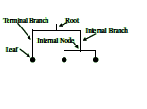
A Useful Tool for Summarizing Similarity Measurements
In order to better appreciate and evaluate the examples given, we will now introduce the dendrogram
The similarity between two objects in a dendrogram is represented as the height of the lowest internal node they share.

Slide 13
Major Clustering Approaches
Partitioning algorithms: Construct various partitions and then evaluate them by some criterion
Hierarchy algorithms: Create a hierarchical decomposition of the set of data (or objects) using some criterion
Density-based: based on connectivity and density functions
Grid-based: based on a multiple-level granularity structure
Model-based: A model is hypothesized for each of the clusters and the idea is to find the best fit of that model to each other
Different ways of measuring similarity

Slide 14
Partitioning Algorithms: Basic Concept
Generates various partitions and then evaluate them by some criterion
Nonhierarchical, each instance is placed in exactly one of K non-overlapping clusters
Since only one set of clusters is output, the user normally has to input the desired number of clusters K.
One of the most popular algoritm is the K-means algorithm

Slide 15
K-means clustering algorithm
Input: a database D, of m records, r₁.... ,rm and a desired number of clusters k
Output: set of k clusters that minimizes the squared error criterion
Begin
randomly choose k records as the centroids for the k clusters;
repeat
assign each record, ri , to a cluster such that the distance between ri and the cluster centroid (mean) is the smallest among the k clusters;
recalculate the centroid (mean) for each cluster based on the records assigned to the cluster;
until no change;
End;

Slide 16
The algorithm begins by randomly choosing k records to represent the centroids (means), m₁, ... , m_{k}‘,of the clusters, C₁, ... ,C_{k}
All the records are placed in a given cluster based on the distance between the record and the cluster mean
If the distance between mi and record r_{j} is the smallest among all cluster means, then record r_{j} is placed in cluster C_{i}
Once all records have been initially placed in a cluster, the mean for each cluster is recomputed.
Then the process repeats, by examining each record again and placing it in the cluster whose mean is closest
Several iterations may be needed, but the algorithm will converge, although it may terminate at a local optimum
The terminating condition is usually the squared-error criterion

Slide 17
Advantage And Disadvantages
Strength
– Simple, easy to implement and debug
– Intuitive objective function: optimizes intra-cluster similarity
–Low complexity:complexity is O(nkt), where t = #iterations
Weakness
– Applicable only when mean is defined, then what about categorical data?
– Often terminates at a local optimum. Initialization is important.
– Need to specify K, the number of clusters, in advance
– Unable to handle noisy data and outliers
– Not suitable to discover clusters with non-convex shapes

Slide 18
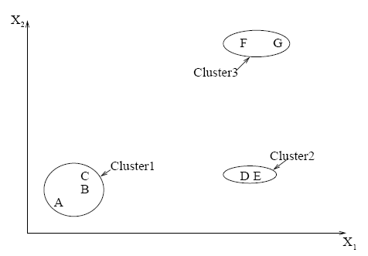
Hierarchical
Use distance matrix as clustering criteria. This method does not require the number of clusters k as an input, but needs a termination condition
Forming clusters from dendograms

Slide 19
Types of hierarchical Clustering
Agglomerative (bottom up)
start with 1 point (singleton)
recursively add two or more appropriate clusters
Stop when k number of clusters is achieved.
Divisive (top down)
Start with a big cluster
Recursively divide into smaller clusters
Stop when k number of clusters is achieved.

Slide 20
Single-Linkage Clustering(hierarchical)
The N*N proximity matrix is D = [d(i,j)]
The clusterings are assigned sequence numbers 0,1,......, (n-1)
L(k) is the level of the kth clustering
A cluster with sequence number m is denoted (m)
The proximity between clusters (r) and (s) is denoted d [(r),(s)]
Algorithm
Begin with the disjoint clustering having level L(0) = 0 and sequence number m = 0.
Find the least dissimilar pair of clusters in the current clustering, say pair (r), (s), according to d[(r),(s)] = min d[(i),(j)] where the minimum is over all pairs of clusters in the current clustering.

Slide 21
Increment the sequence number : m = m +1. Merge clusters (r) and (s) into a single cluster to form the next clustering m. Set the level of this clustering to L(m) = d[(r),(s)]
Update the proximity matrix, D, by deleting the rows and columns corresponding to clusters (r) and (s) and adding a row and column corresponding to the newly formed cluster. The proximity between the new cluster, denoted (r,s) and old cluster (k) is defined in this way: d[(k), (r,s)] = min d[(k),(r)], d[(k),(s)]
If all objects are in one cluster, stop. Else, go to step 2

Slide 22
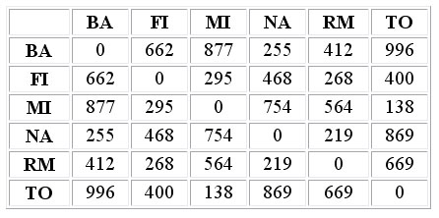
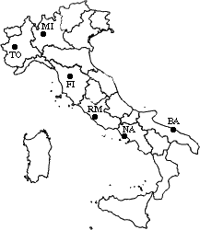
Hierarchical clustering example
Let’s now see a simple example: a hierarchical clustering of distances in kilometers between some Italian cities. The method used is single-linkage.
Input distance matrix (L = 0 for all the clusters):

Slide 23
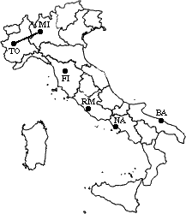
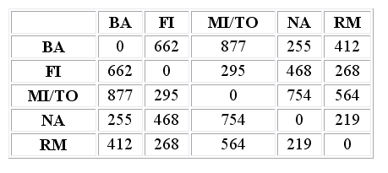
The nearest pair of cities is MI and TO, at distance 138. These are merged into a single cluster called "MI/TO". The level of the new cluster is L(MI/TO) = 138 and the new sequence number is m = 1. Then we compute the distance from this new compound object to all other objects. In single link clustering the rule is that the distance from the compound object to another object is equal to the shortest distance from any member of the cluster to the outside object. So the distance from "MI/TO" to RM is chosen to be 564, which is the distance from MI to RM, and so on.
After merging MI with TO we obtain the following matrix:

Slide 24
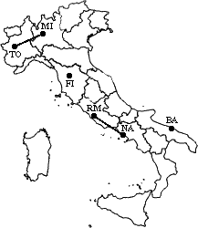
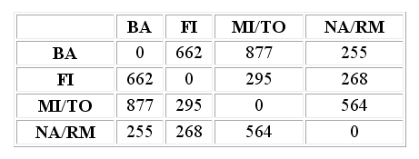
min d(i,j) = d(NA,RM) = 219 => merge NA and RM into a new cluster called NA/RM L(NA/RM) = 219 m = 2

Slide 25
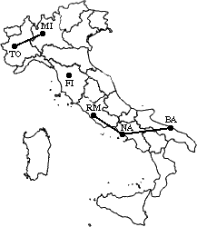
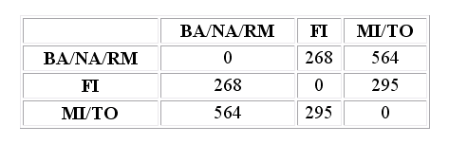
min d(i,j) = d(BA,NA/RM) = 255 => merge BA and NA/RM into a new cluster called BA/NA/RM L(BA/NA/RM) = 255 m = 3

Slide 26
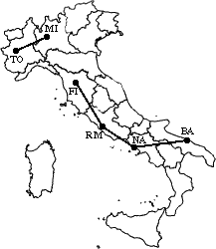
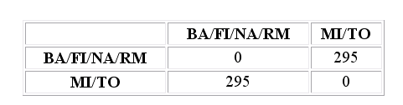
min d(i,j) = d(BA/NA/RM,FI) = 268 => merge BA/NA/RM and FI into a new cluster called BA/FI/NA/RM L(BA/FI/NA/RM) = 268 m = 4

Slide 27
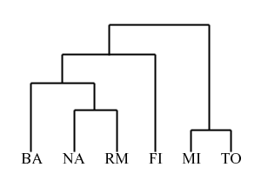
Finally, we merge the last two clusters at level 295.
The process is summarized by the following hierarchical tree:

Slide 28
Advantages
Dendograms are great for visualization
Provides hierarchical relations between clusters
Shown to be able to capture concentric clusters
Disadvantages
Not easy to define levels for clusters
Experiments showed that other clustering techniques outperform hierarchical clustering

Slide 29
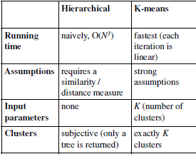
Comparisons

Slide 30
Bibliography
Fundamentals_of_Database_Systems__4th_Edition_ By
Ramez Elmasri and Shamkant B. Navathe
2.A. K. Jain and R. C. Dubes. Algorithms for Clustering Data. Printice Hall, 1988.
3. Dr. M.H. Dunham http://engr.smu.edu/~mhd/dmbook/part2.ppt. 4. Database System Concepts, Silberschatz, Korth, Sudarshan

Slide 31
Thank You

